Slide 1

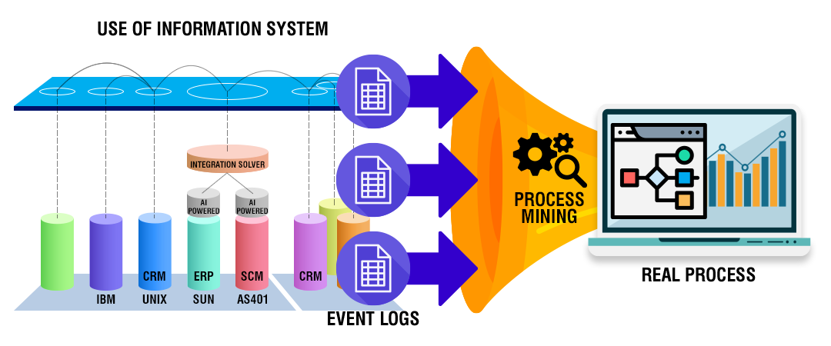
Ferret Miner:
A Process Mining Case Study
Martin Alvarez Lopez
Graduate Student
Student ID: 012328706
MS in Software Engineering
Carlos Hernandez
Graduate Student
Student ID: 015286791
MS in Computer Engineering
Hardy Leung
Graduate Student
Student ID: 016711877
MS in Software Engineering
Divyam Sobti
Graduate Student
Student ID: 016013348
MS in Artificial Intelligence

Slide 2
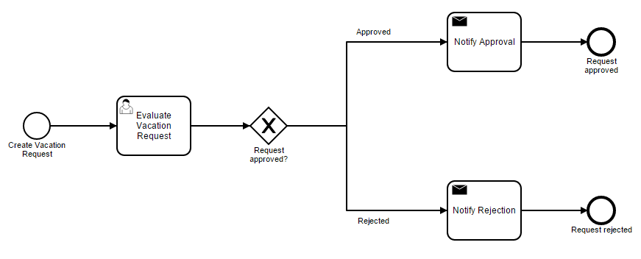
Ferret Miner:
A Process Mining Case Study

Slide 3
Ferret Miner:
A Process Mining Case Study
Table of content
Introduction Process Mining
Motivation
Challenges
Approach
Implementation
Findings and Conclusion
Future Scope
Notes:
Composition of Process Mining
Motivation
(3.5 mins)
Challenges
Approach
(>3 mins)
Implementation
Findings (Results) Conclusion
(4 mins)
Future Scope
(2 min)

Slide 4
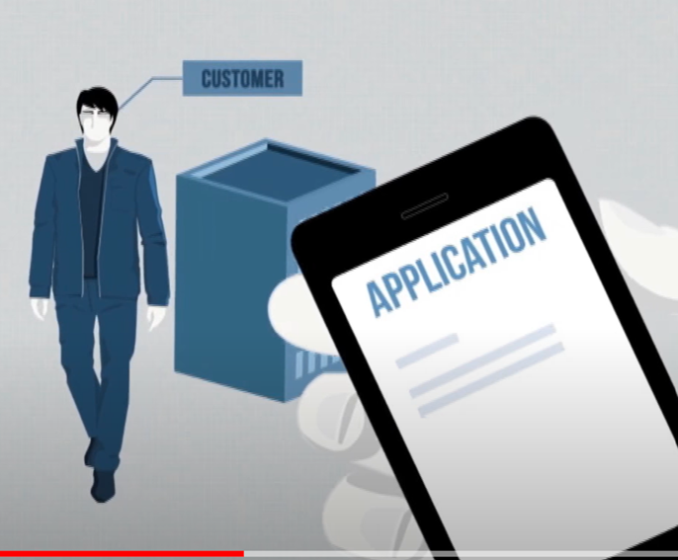
Ferret Miner:
A Process Mining Case Study
Process Mining:
Digital Information Systems
Nowadays, most organizations use information systems to support the execution of their business processes, generating huge amounts of data information.

Slide 5
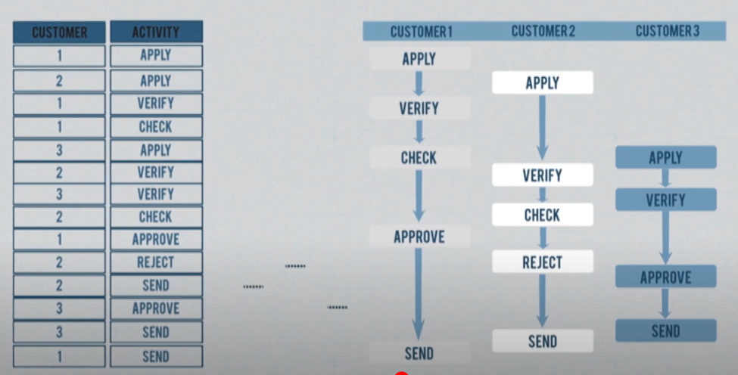
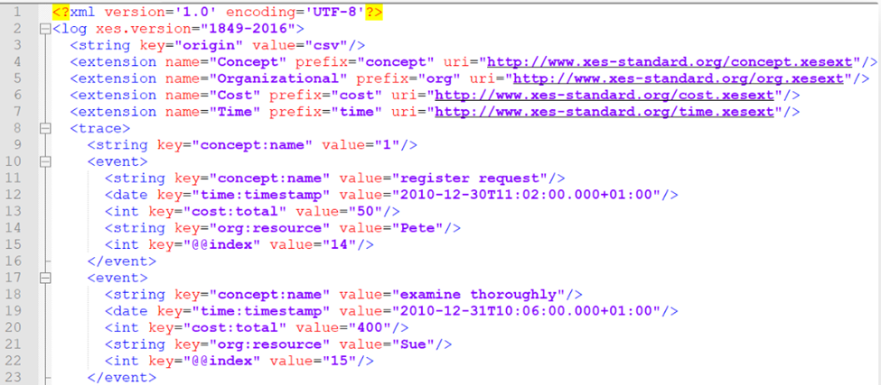
Ferret Miner:
A Process Mining Case Study
Event Data Log
.XES Standard

Slide 6
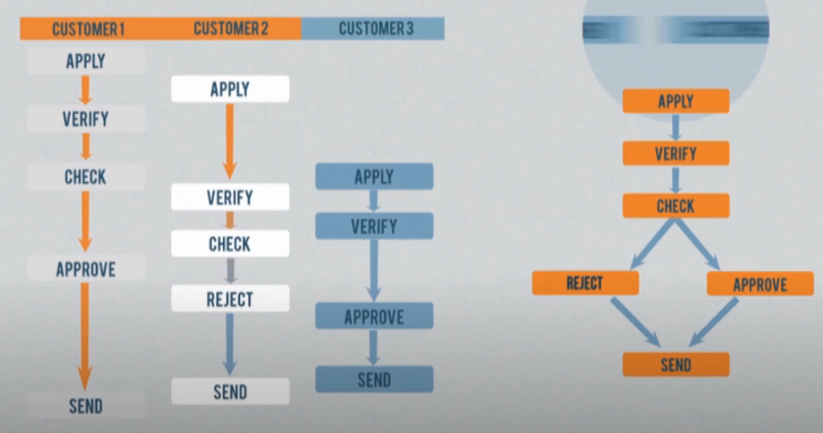
Ferret Miner:
A Process Mining Case Study
Process Mining - Discover Organizational Structure:

Slide 7
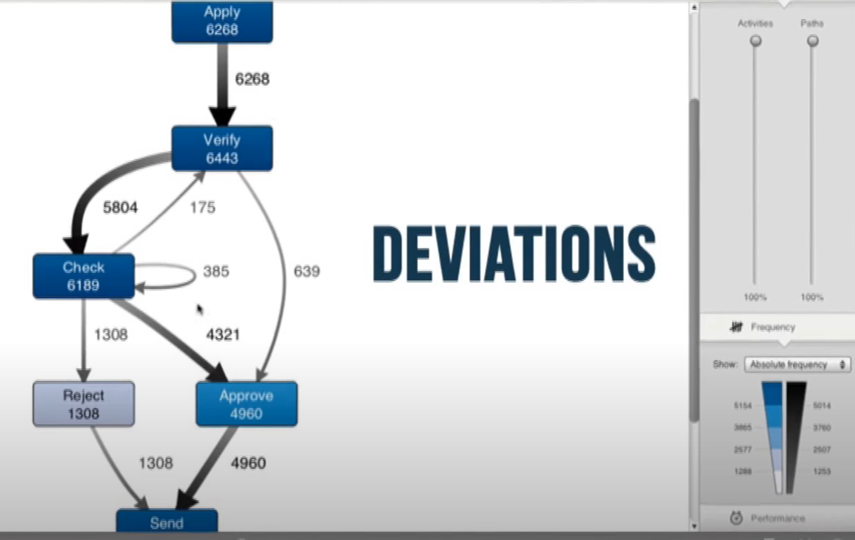
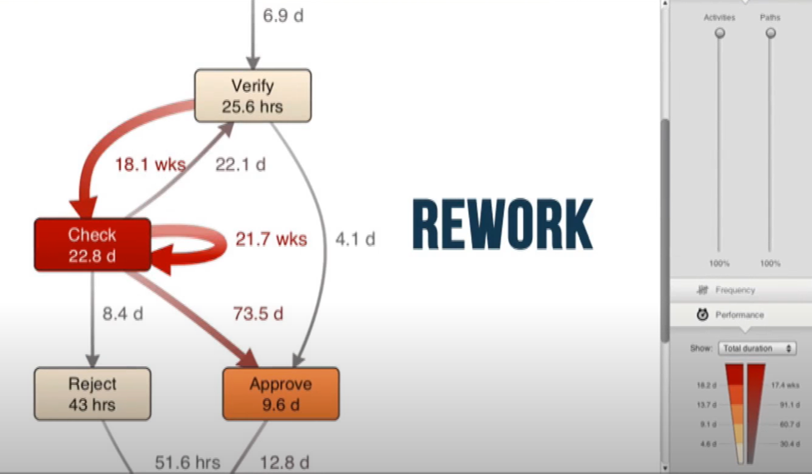
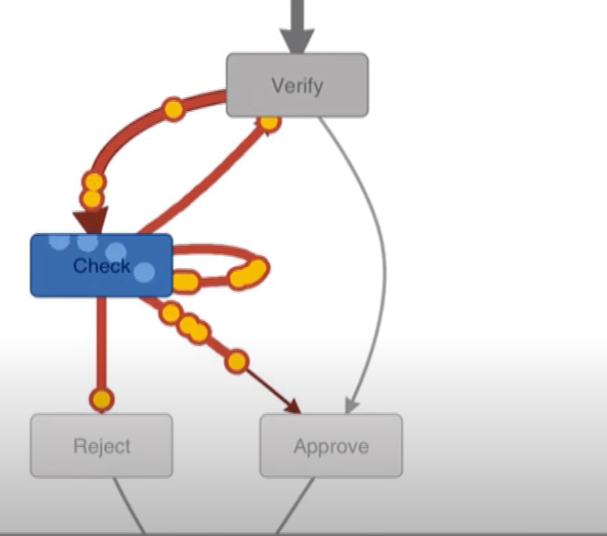
Ferret Miner:
A Process Mining Case Study
Process Mining - Mapping:
Helps Understand and Improve the Process
Bottlenecks

Slide 8
Motivation
Problem
About Ferrent Miner
Apply a solution technique to overcome the challenges of big data generation and processing in a real life scenario.
In this project we analyzed real-life event log data from the travel reimbursement process at Eindhoven University of Technology (ETU/e). We set out to identify the bottlenecks in the process of a travel declaration. Use Process Mining techniques to generate control-flow models that help identify the bottleneck by finding the biggest delay in the process
Notes:
Motivation: We wanted to work on something that was applicable for the everyday worker and help any business.
Companies hold a massive amount of data, yet its hardly used for data driven decisions for process approach.

Slide 9
Ferret Miner:
A Process Mining Case Study
CHALLENGES
Process mining is a relatively new technique. So had to learn everything starting from preprocessing to model creation
PM4PY is in its early stages and its limited compared to other proprietary enterprise software.
PM4PY is constantly changing as before a week PM4PY used to read data as event logs and now its reading as dataframe
Appropriate interpretation of XES files and how the data was formatted and what it meant
Unique noise coming from outside processes, difficult to identify. Cannot use statistics to view outliers. There were no null or missing values.

Slide 10
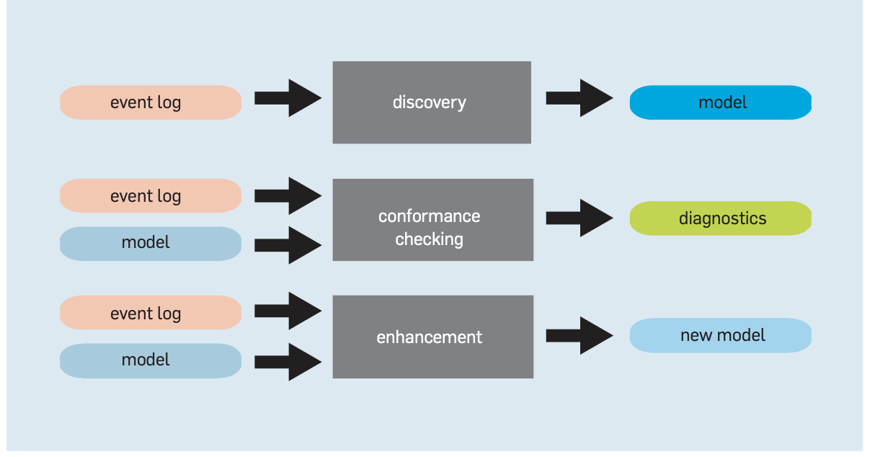
Ferret Miner:
A Process Mining Case Study
APPROACH
Understanding the problem
Understanding which data we need
Domestic declaration
International declaration
Process Mining
Process Discovery
Conformance Checking
Model Enhancement

Slide 11
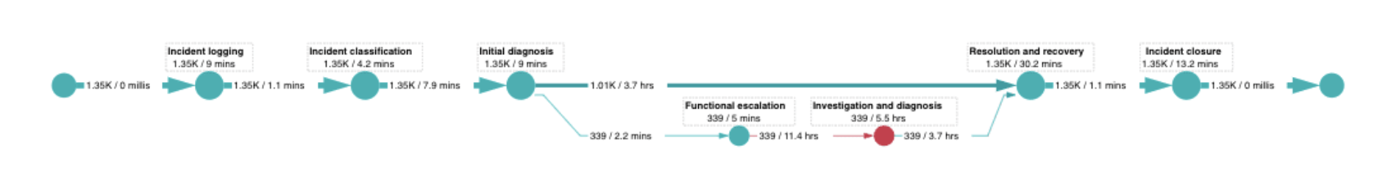
Ferret Miner:
A Process Mining Case Study
APPROACH
Preprocessing the data
Process discovery to techniques to generate :
DFG(Direct Flow Graph)
Petri Nets

Slide 12
Implementation
Preprocessing
Common Issues with Event Logs
Noise/Anomalous Data:
data codes, inconsistent formats, such as timestamps
Missing Data
Typically mandatory for systems to record data, however, there may be issues/temporary lapses with any system
Irrelevant Data
Duplicated Data

Slide 13
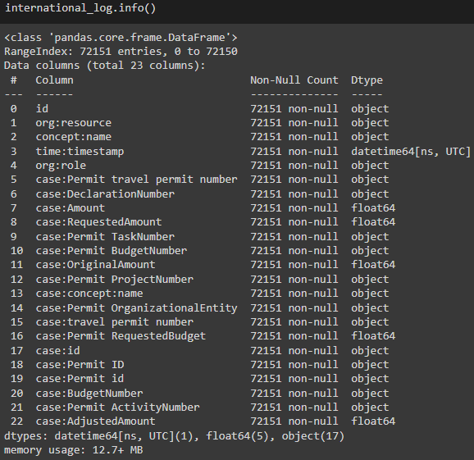
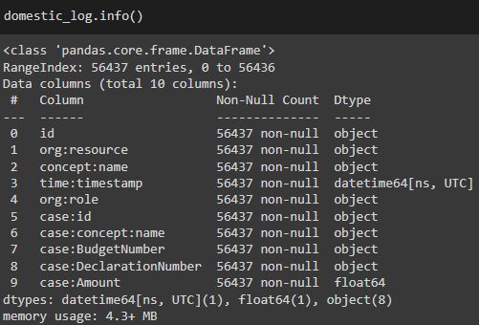
Implementation
Preprocessing

Slide 14
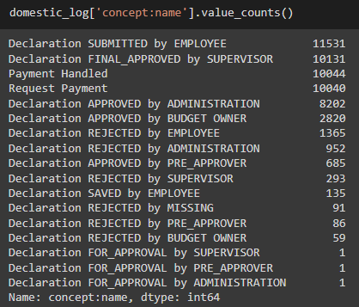
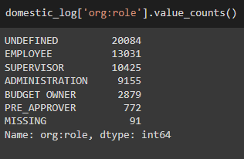
Implementation
Preprocessing

Slide 15
Implementation
Preprocessing

Slide 16
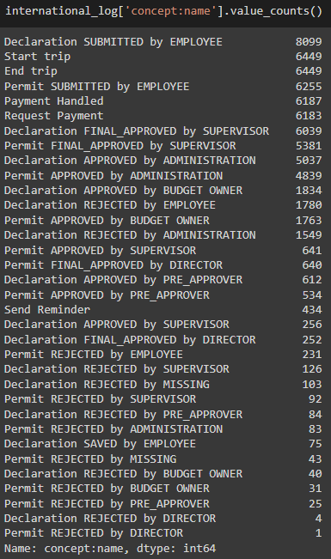
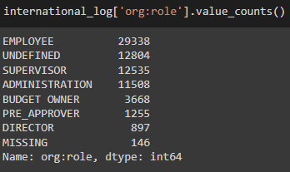
Implementation
Preprocessing

Slide 17
Implementation
Preprocessing
Domestic Declarations Log
No Null or Anomalous Data
Some entries attributes had ‘SYSTEM’, ‘STAFF MEMBER’, ‘UNKNOWN’, or ‘MISSING’ as their value.
Solution: removed entries with ‘MISSING’ or ‘UNKNOWN’
Removing entries with vague values like this may have unintended consequences.
Sometimes it's not important to know who executed an activity for a case, the only thing that matters is if it was done.
Payment handled, Reminder Sent, Etc

Slide 18
Implementation
Preprocessing
International Declarations Log
Similar to Domestic Log Declaration’s Data Cleaning
Duplicate Data
Solution: Merged Attributes
Irrelevant Data
Solution: Dropped
International Declaration process interjects with a Permit Process
For international trips, permission is needed from a supervisor first by submitting filing a travel-permit which should be approved BEFORE making any arrangements.

Slide 19
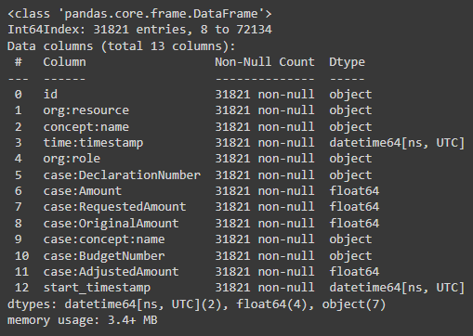
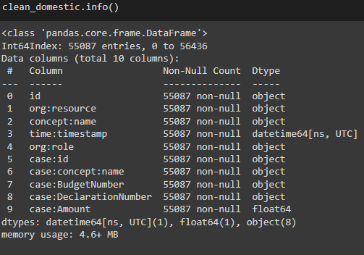
Implementation
Preprocessing

Slide 20
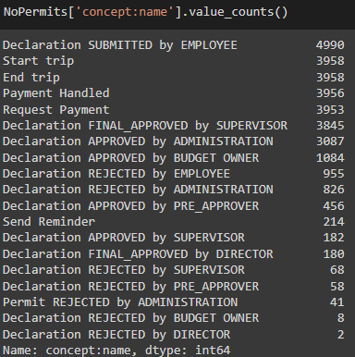
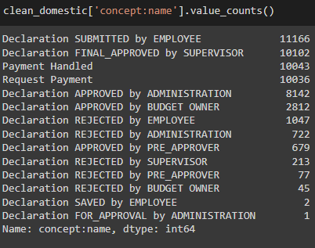
Implementation
Preprocessing

Slide 21
Implementation
Preprocessing
What about infrequent activities?
Naive approach:
Dropping infrequent activities
More efficient approach:
Filtering and retaining top variants. In our case we kept the top 15-25% variants.

Slide 22
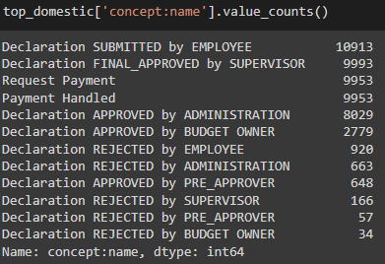
Implementation
Preprocessing

Slide 23
Implementation
Models
Frequency DFG for both Domestic and International Declarations
Performance (edges: mean time) DFG for both Domestic and International Declarations

Slide 24
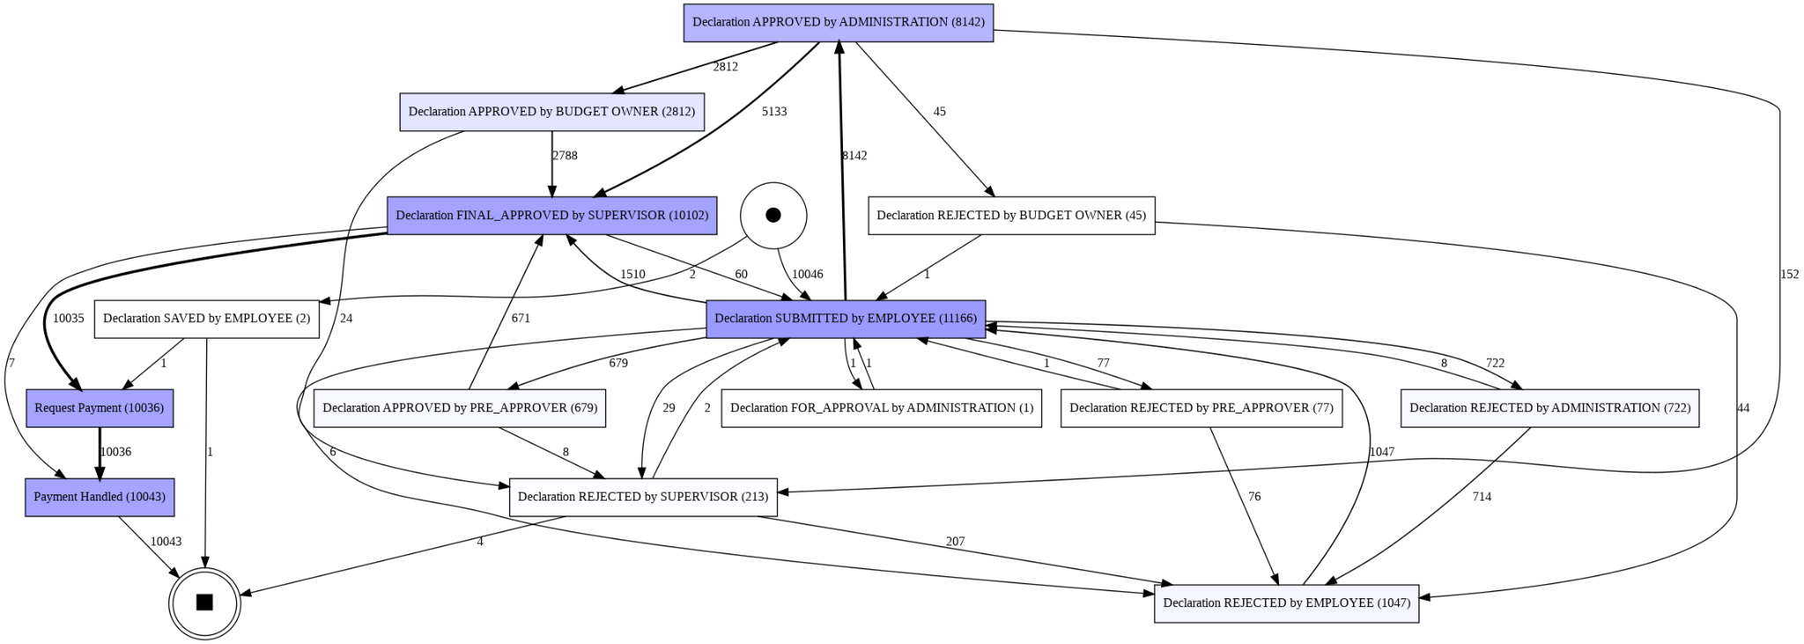
Implementation: Model
Full Domestic Declarations

Slide 25
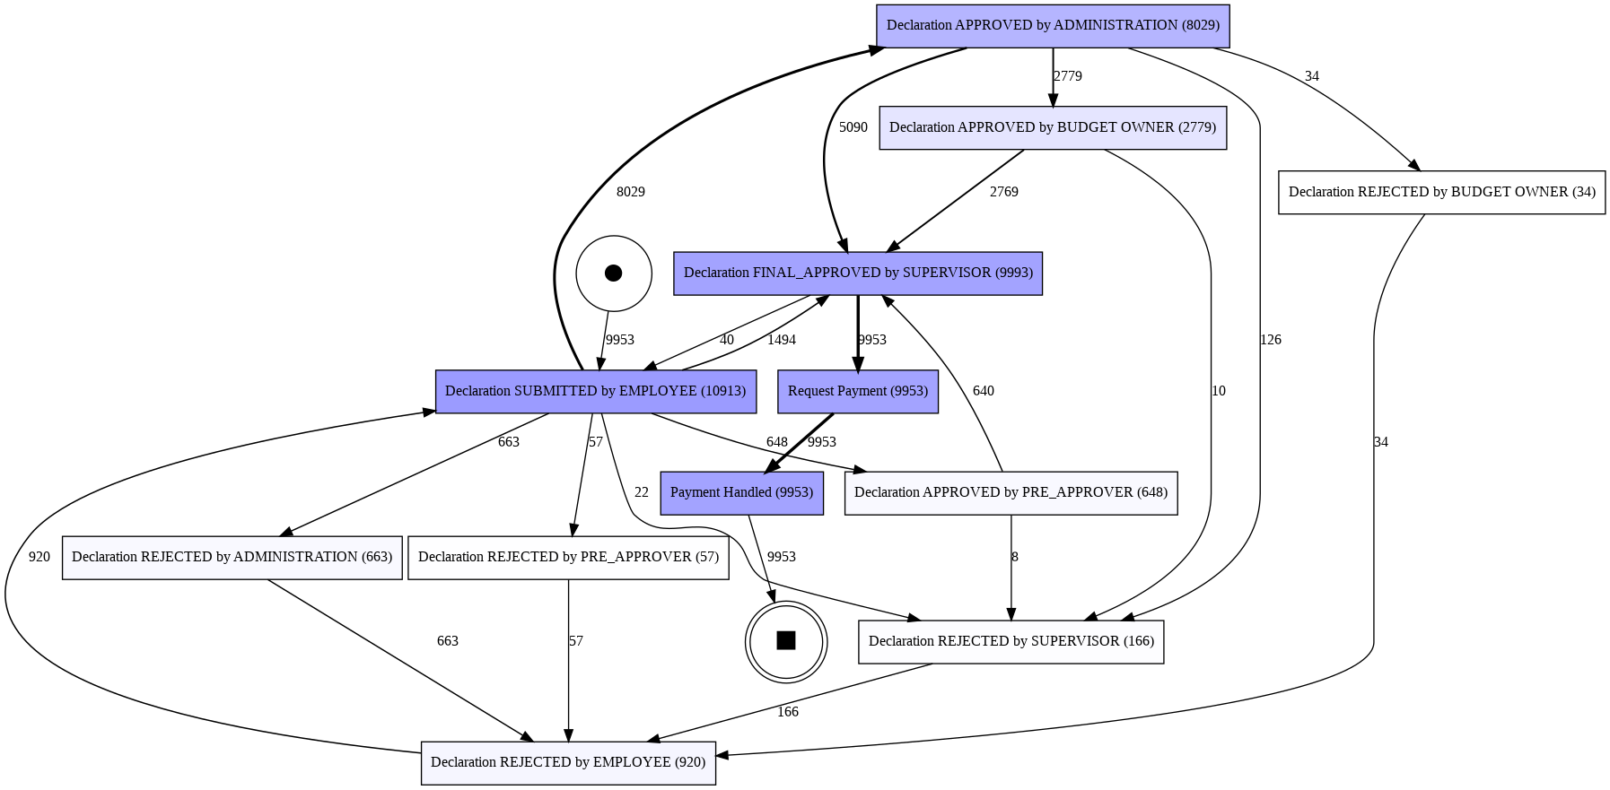
Implementation: Model
Top 25% Domestic Declarations

Slide 26
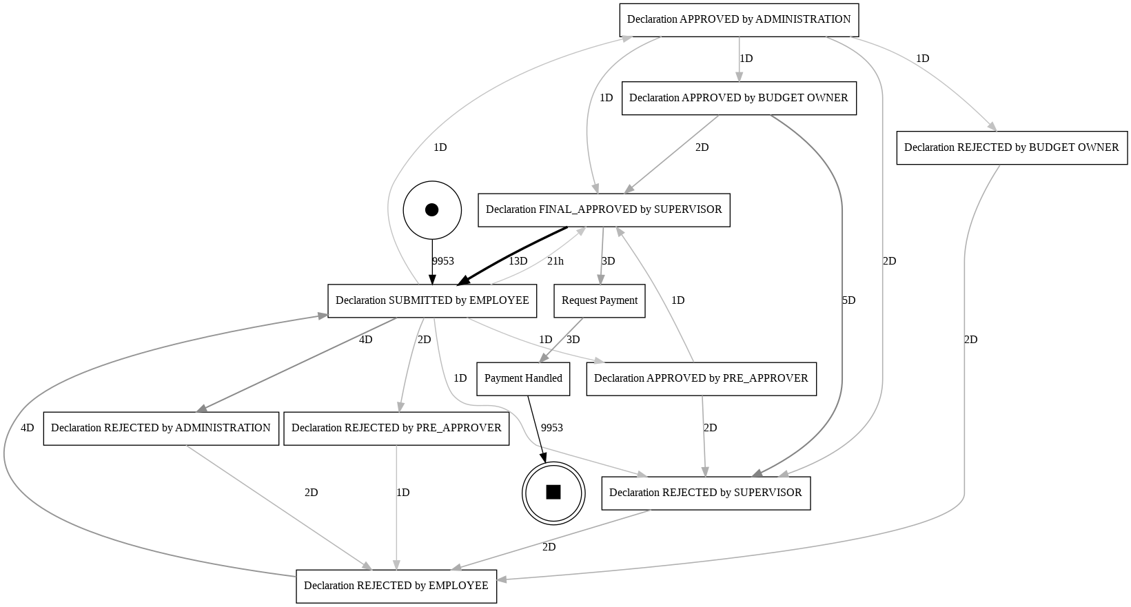
Implementation: Model
Top 25% Domestic Declarations

Slide 27
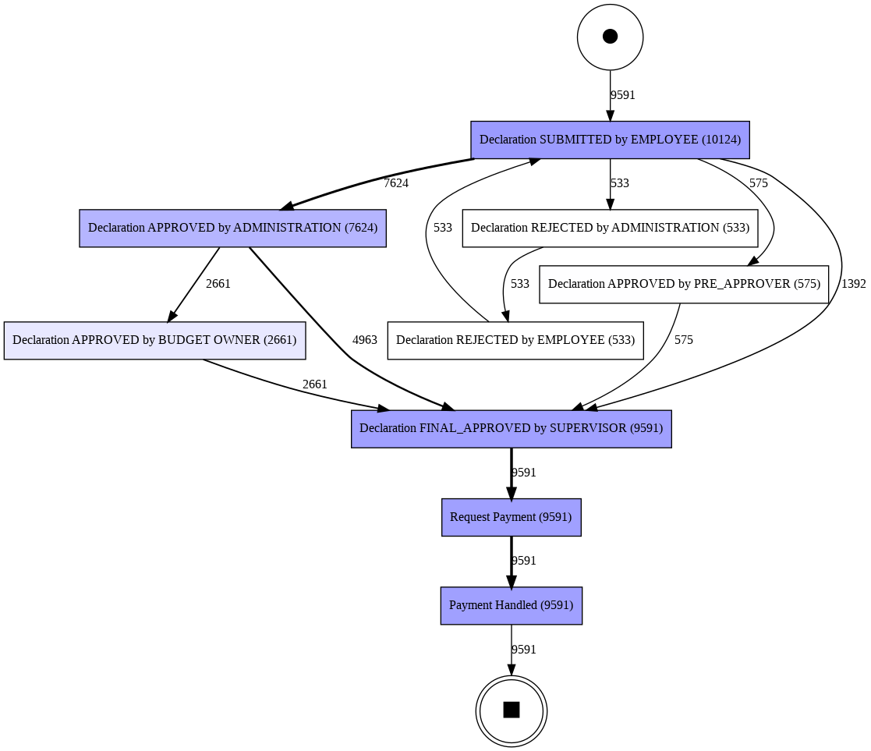
Implementation: Model
Simplified Domestic Declarations

Slide 28
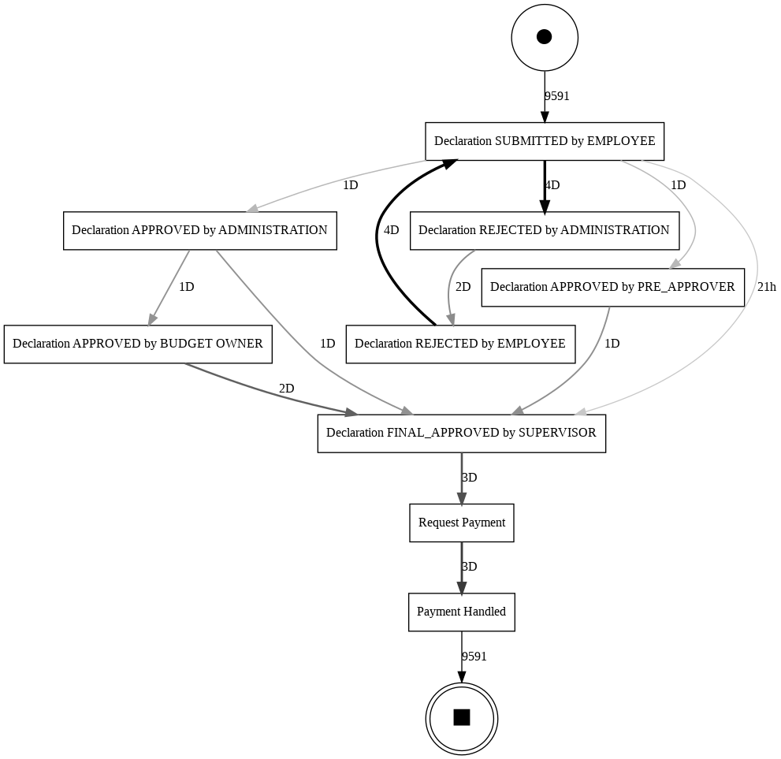
Implementation: Model
Simplified Domestic Declarations

Slide 29
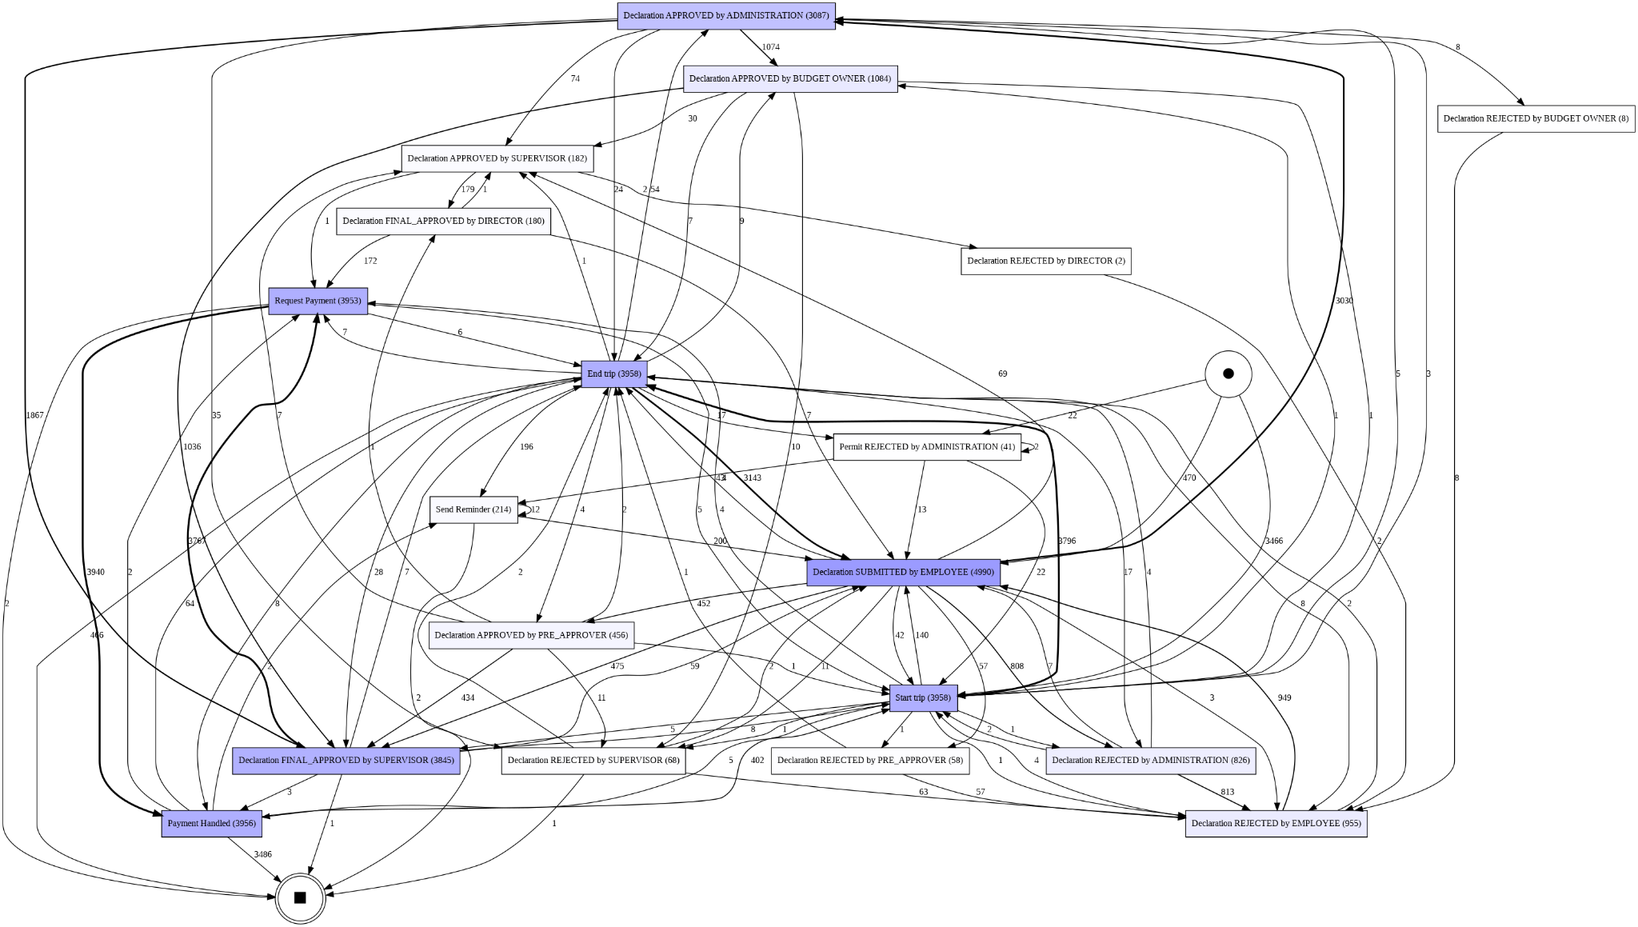
Implementation: Model
Full International Declarations

Slide 30
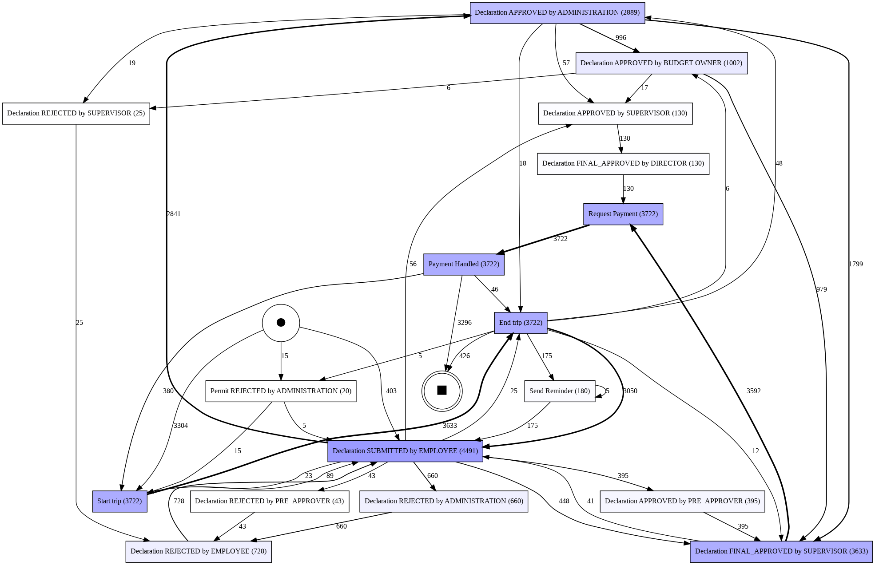
Implementation: Model Naive
Top 15% International Variants

Slide 31
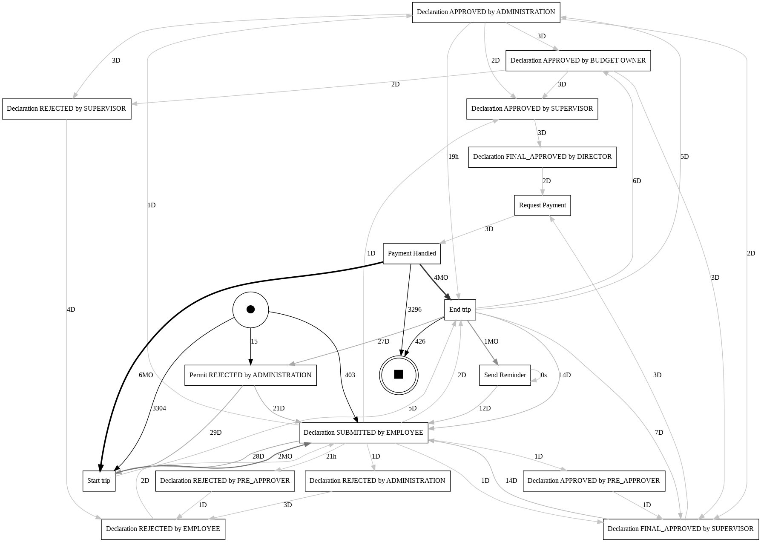
Implementation: Model Naive
Top 15% International Variants

Slide 32
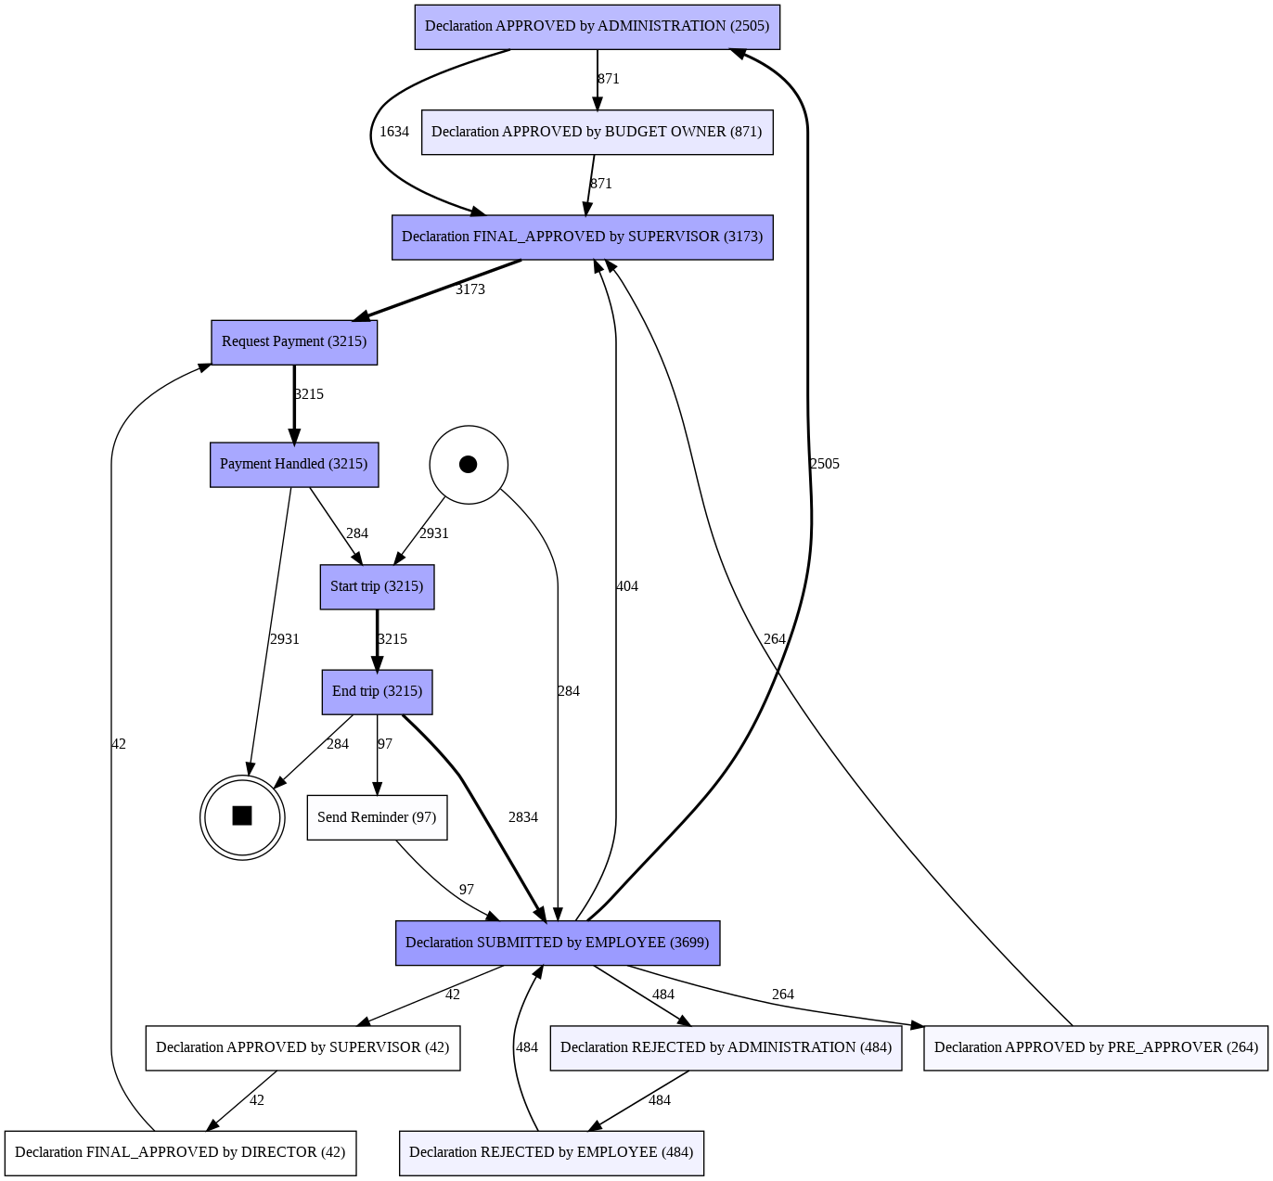
Implementation: Model Naive
Simplified International Variants

Slide 33
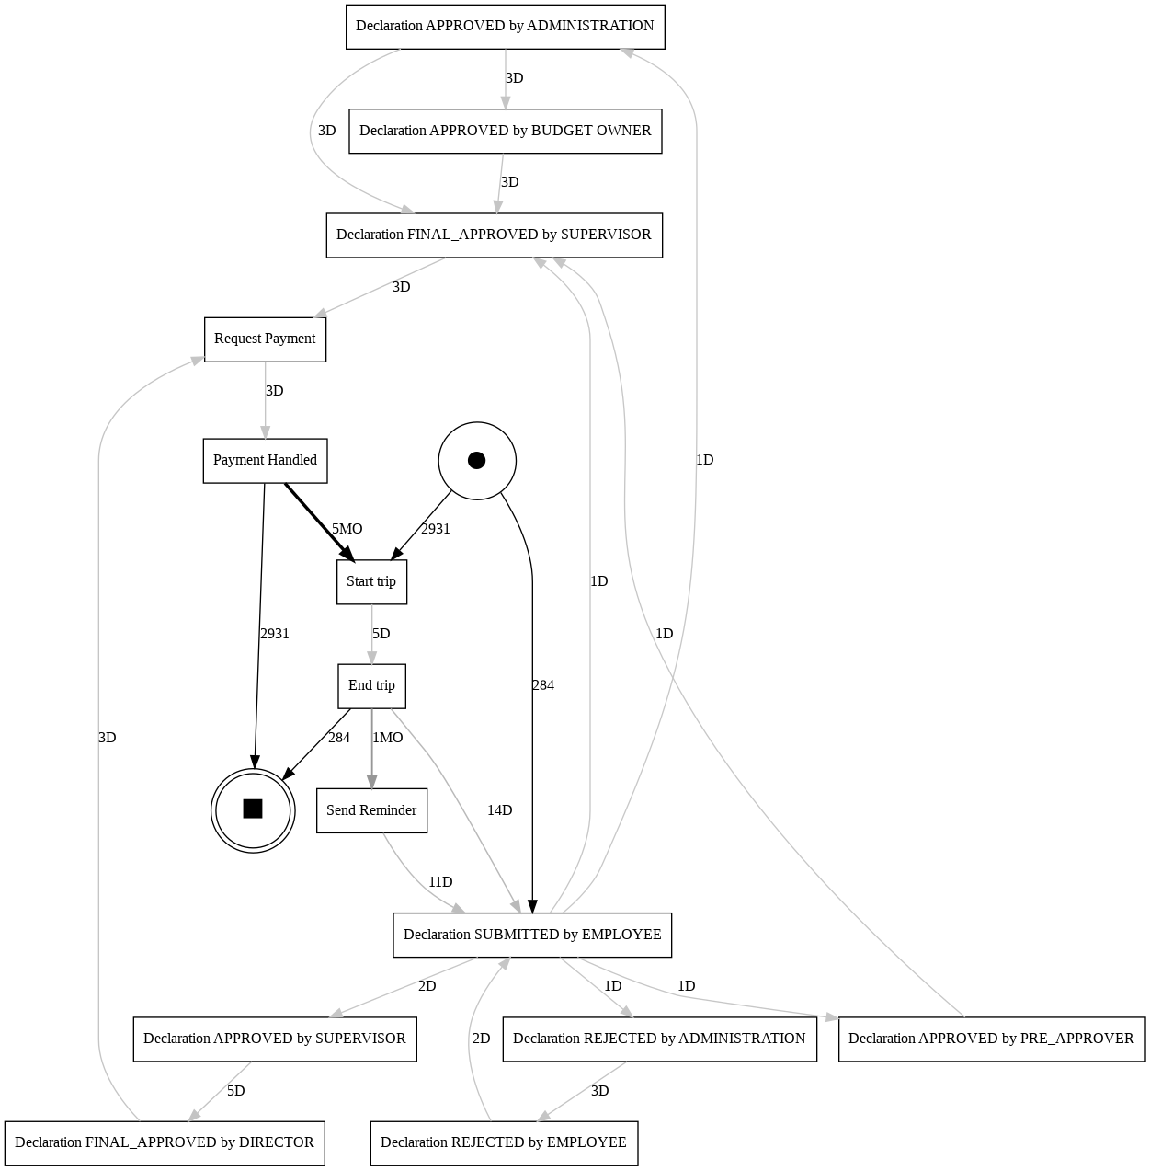
Implementation: Model Naive
Simplified International Variants

Slide 34
Findings
Results
Looking at both models for International and Domestic declarations, we identified several activities with longer than average times.
There were edges that had longer times but had logical explanations
Declaration approved → Start Trip, Start Trip → End Trip
For us, a bottleneck is a mixture of frequent and longer mean time event.

Slide 35
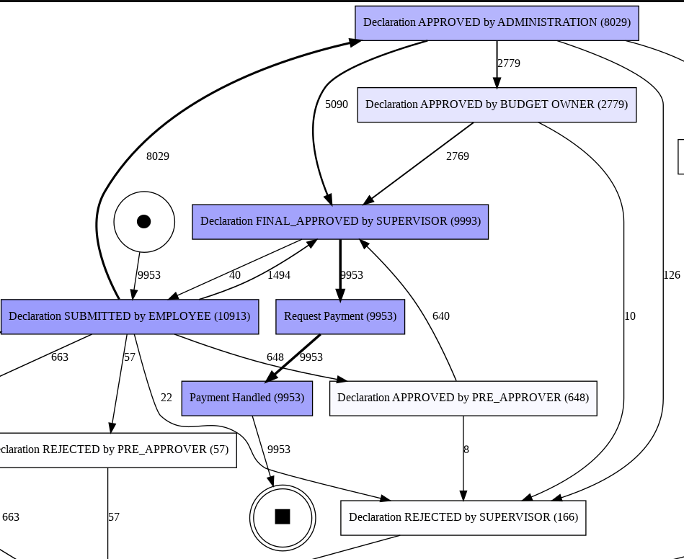
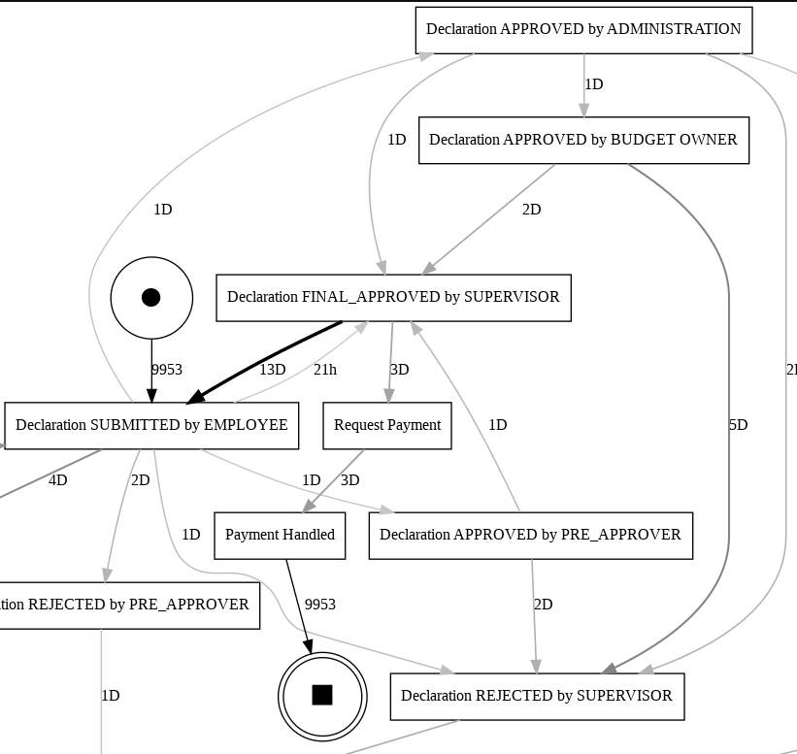
Findings
Results: Domestic Declarations

Slide 36
Findings
Results: Domestic Declarations

Slide 37
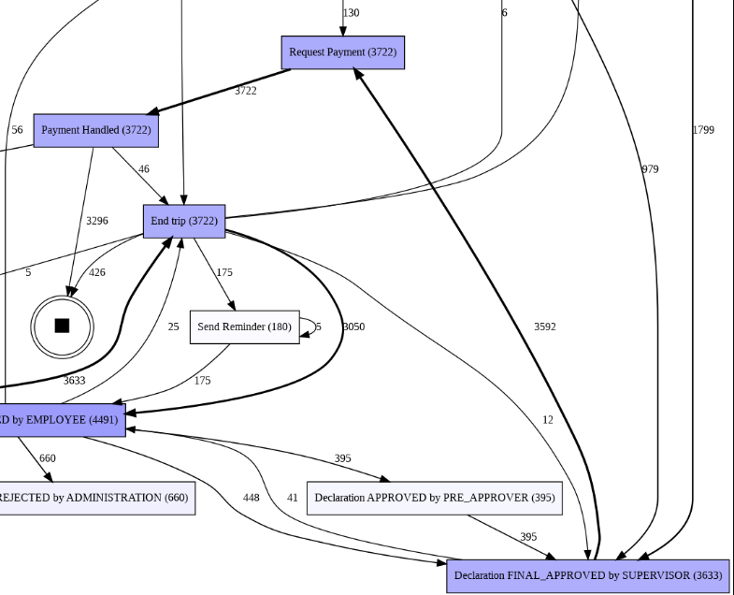
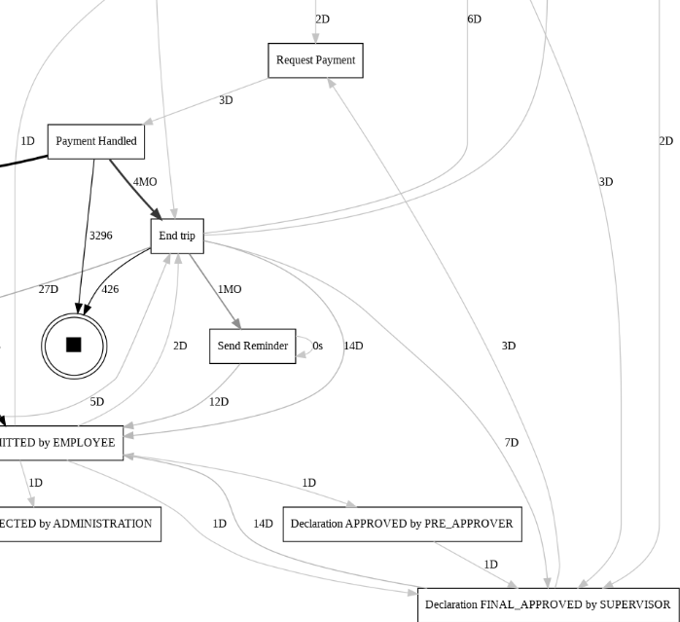
Findings
Results: International Declarations

Slide 38
Findings
Results: International Declarations

Slide 39
Conclusion
Answer/Solution
Where are the bottlenecks in the process of a travel declaration?
The biggest bottleneck is the supervisor activities for both International and Domestic declarations. For the supervisor to do the final approval and request payment, it takes on average 4-5 days.
If we simply have to identify one event, “Payment Handled” is the biggest bottleneck, however, it might be outside of the organization’s control and may be more of a financial institution issue.
Drawbacks
PM4PY does not allow us to customize the performance graph output, instead, it rounds up the time to days instead of leaving it in an hour format. Also, PM4PY does not have a method of superimposing the frequency and performance.

Slide 40
Ferret Miner:
A Process Mining Case Study
Future Work I – Conformance Analysis
Conformance analysis helps us identify how well the data fits the model
Method I – Token-based Replay based on Petri-Net
Simulate each trace to completion, but keep track of additional token added to avoid deadlock (A), and check for unused tokens at completion (B). Unfit if A > 0 or B > 0
Method II – Alignment Analysis
Similar to token-based replay but “align” the events of a trace to a legal and model-fitting trace subject to cost. This is more informative, but more expensive to run
Method III – Behavior Analysis
These techniques can be used to better identify the hows and whys of non-conformance, and to build better models. We will share an example using our model in the following (under development)
Notes:
Let’s now talk about our future work.
First, it would be interesting to look more into conformance analysis.
The most common technique is token-based replay, which is based on the Petri-net converted from the process model
For each trace, we would simulate the execution. The use of Petri-net allows us to do that accurately in a mathematically sound way.
There are also alignment and behavior analysis that are more sophisticated, more informative, but take a longer time to run.
Together, these techniques can be used to better identify the hows and whys of non-conformance, and help us build better models.

Slide 41
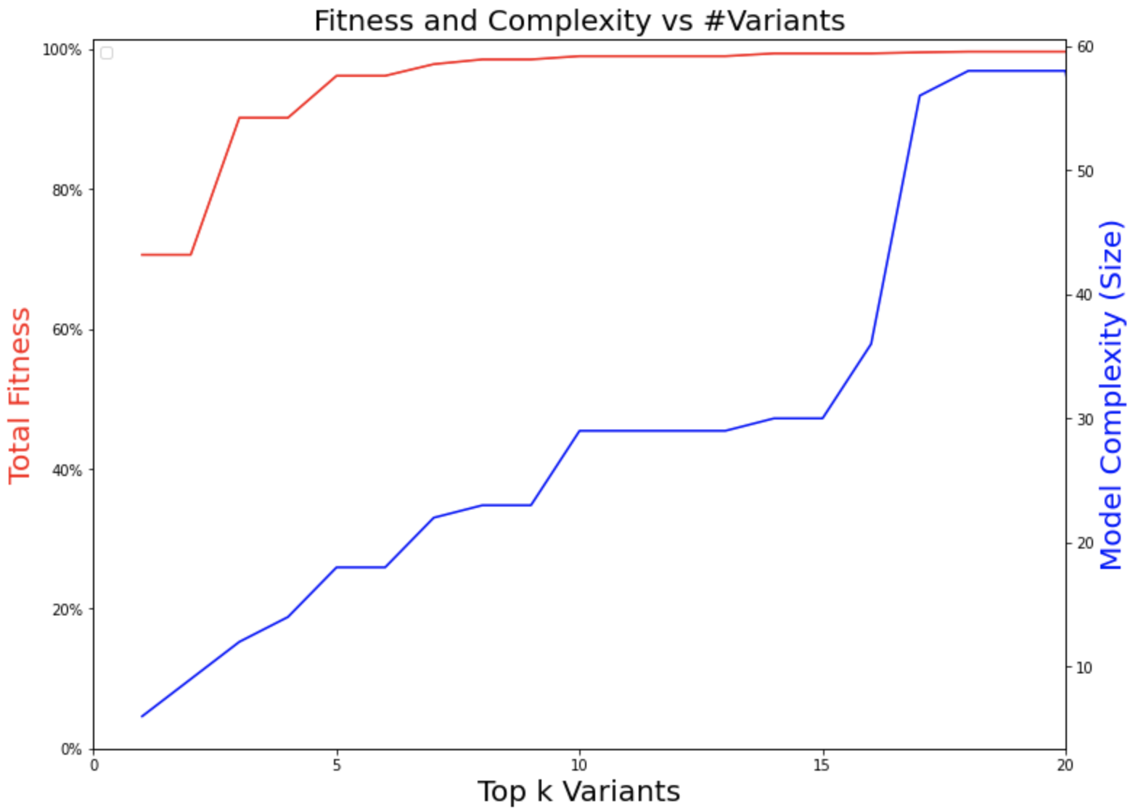
Ferret Miner:
A Process Mining Case Study
Conformance Checking
Given a process model M (discovered or explicitly modeled)
Individual Fitness based on Token-based Replay
can a trace be executed in the process tree?
Total Fitness
sum(individual fitness) / number of traces
Trade-off between model complexity and total fitness
In our experiment
Top 3 variants explain 90%
Top 18 variants explain 99% but at what cost?
Notes:
Let me use our model as an example. We conduct an experiment to see how total fitness (in red) and model complexity (in blue) changes as we include more variants.
I must point out getting to 100% total fitness is not necessarily a desirable goal. It is not hard to get 100%, you just need to include all variants.
Instead, what we are looking for is a tradeoff. On the one hand, you want the model to be robust enough to elegantly explain the process. On the other hand, you don’t want to over-build the model to make it so complex that it is hard to reason about.
In our case, the top 3 variants can explain 90% of the traces. But if we blindly up the ante to 18 variants, we can now account for 99% of the traces, but the model is 5 times bigger, and much harder to understand.

Slide 42
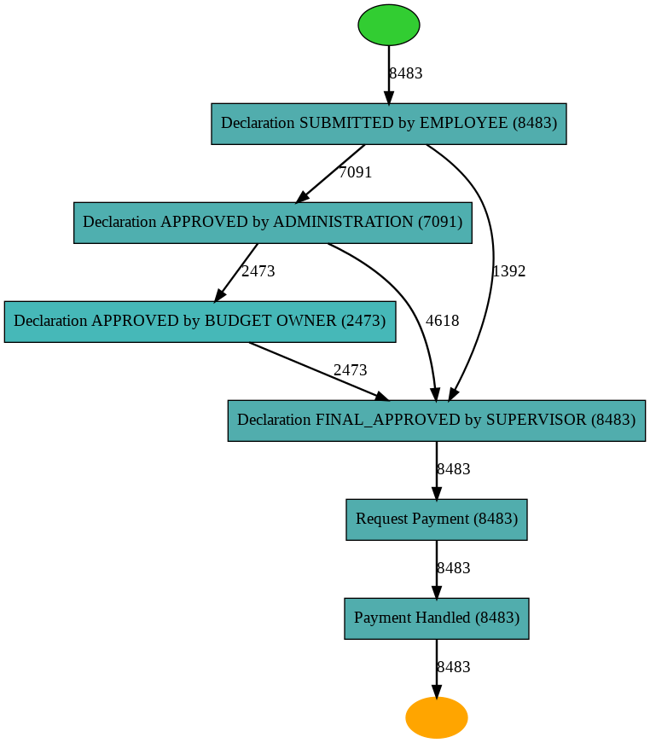
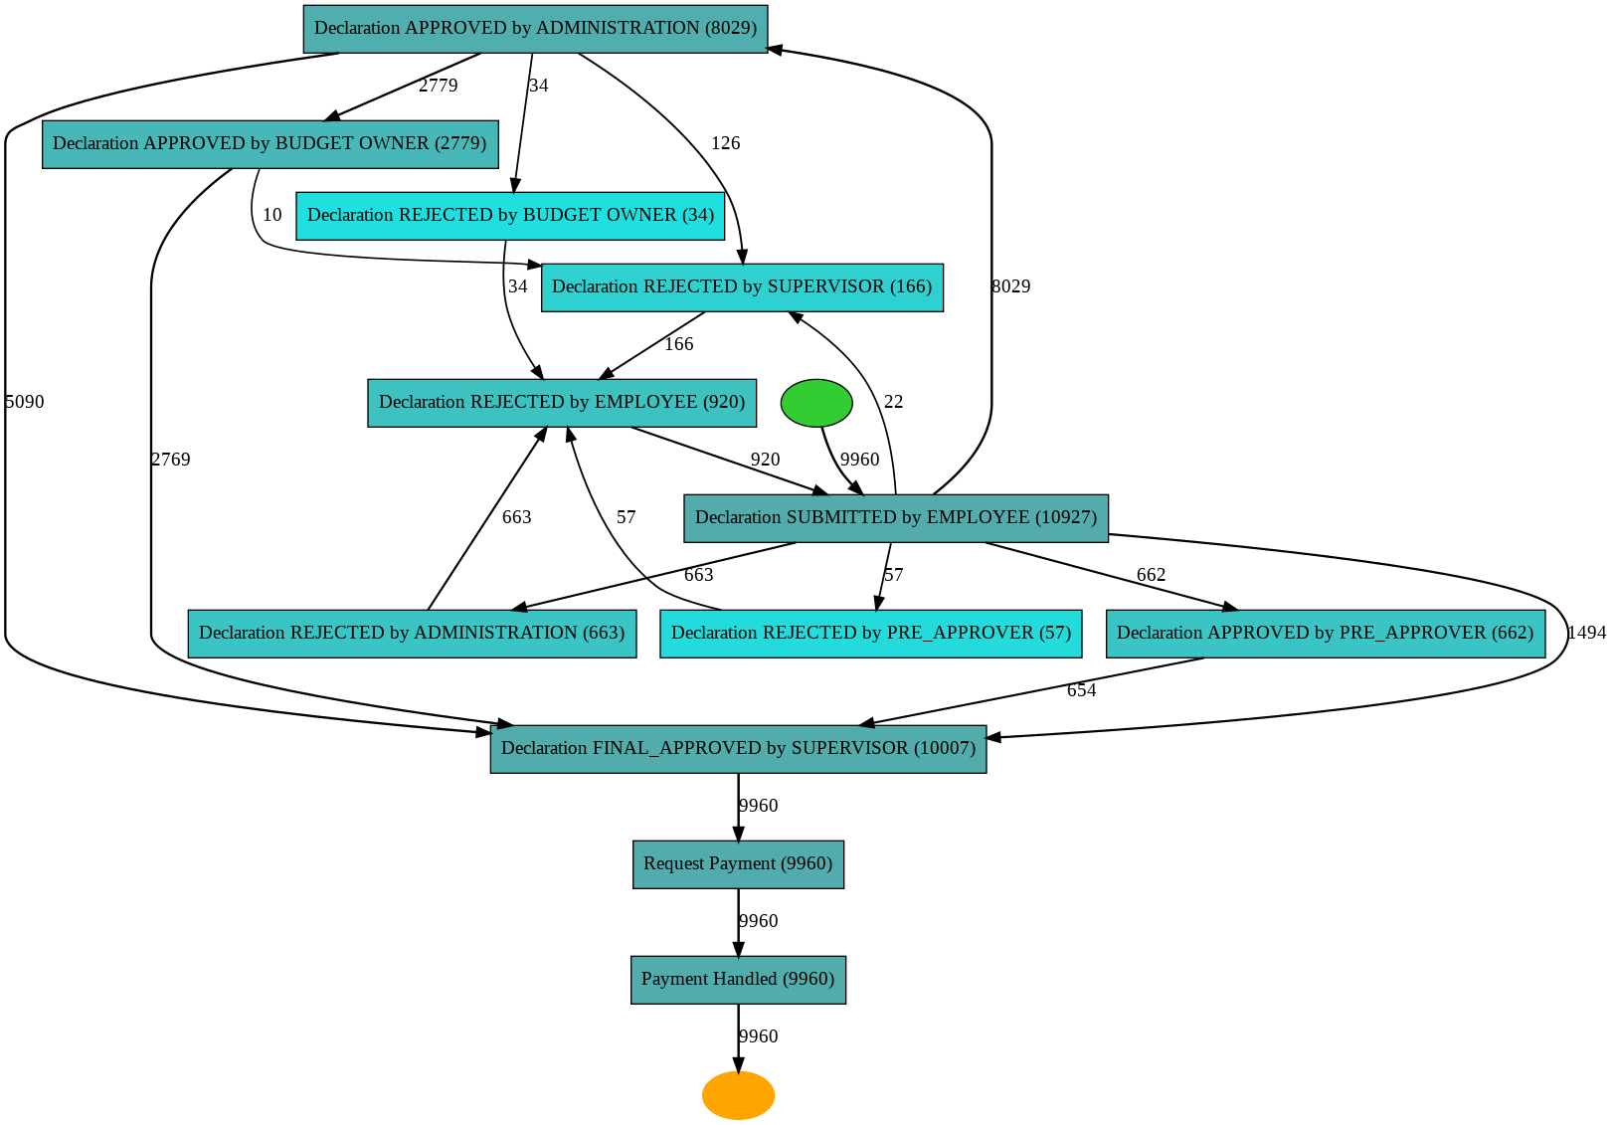
Ferret Miner:
A Process Mining Case Study
Conformance Checking (k = 3, k = 18)
Notes:
These are the heuristics nets extracted with k = 3 and 18 respectively.
The one on the left is very minimalist. Even then, this net can account for 90% of the traces.
The one on the right is much more complex.

Slide 43
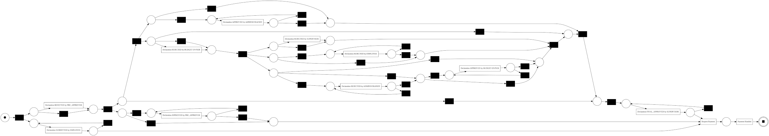
Ferret Miner:
A Process Mining Case Study
Conformance Checking (k = 3, k = 18) – the Petri Net Looks Far Worse
Notes:
The actual petri nets look much worse.

Slide 44
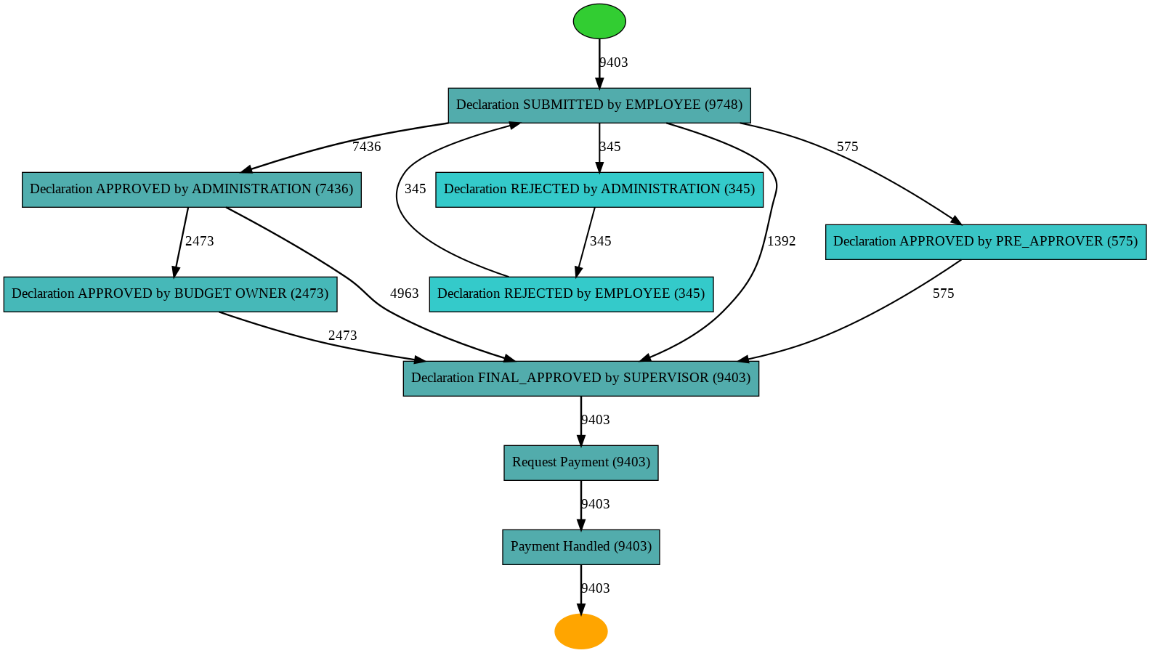
Ferret Miner:
A Process Mining Case Study
Conformance Checking (k = 5, Sweetspot)
Notes:
The sweet spot is k = 5, where we can explain 96% of the traces. It’s quite robust and easy to understand.
And it can properly capture the submission, approval, rejection, resubmission, and the final payment.

Slide 45
Ferret Miner:
A Process Mining Case Study
Conformance Checking (k = 5, Sweetspot)
Notes:
And the petri net is reasonable.

Slide 46
Ferret Miner:
A Process Mining Case Study
Future Work II – ML and Timely Analysis
We would consider using ML techniques:
To perform flow analysis – For example, predict likelihood of resubmission, rejection, payment delay, or over-budget based on other variables (time since submission, request amount, prior owner approval)
To predict mean-time-to-trace-completion for “happy paths”. This can give administrators (and perhaps employees) idea about the time frame of payment in best-case scenario
Detect non-compliance “as it happens” and send alert to administrators
Generalize the conformance tradeoff analysis as a possible enhancement to PM4PY
Notes:
Another area of interest is to apply machine learning techniques to perform perform flow analysis
– For example, predict likelihood of resubmission, rejection, payment delay, or over-budget based on other variables (time since submission, request amount, prior owner approval)
And to predict mean-time-to-trace-completion for “happy paths”.
This can give administrators idea about the time frame of payment in best-case scenario
We can also look into detecting non-compliance “as it happens” and send alert to administrators
This concludes our talk. Thank you.

Slide 47

Ferret Miner:
A Process Mining Case Study

